Slide 1
Job Scraping Project
ITC Data Science, Project # 1

Slide 2
Outline
Scrape list of jobs from Secret Tel Aviv
Advantages:
simple
useful
columnar
Disadvantages:
small data set

Slide 3
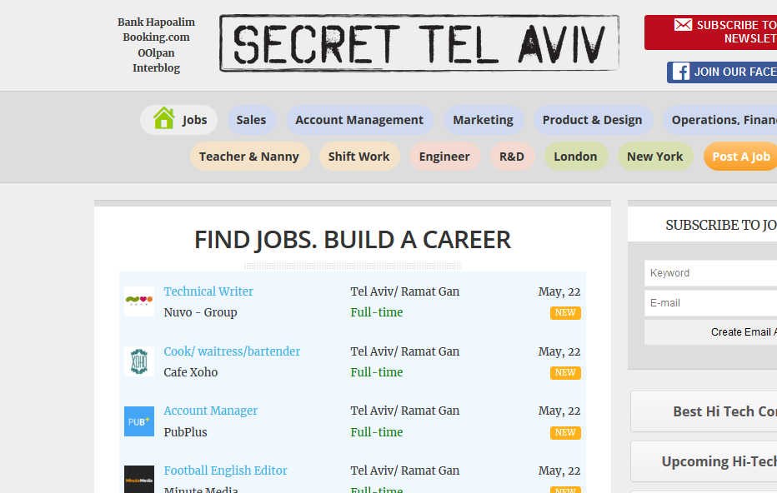

Slide 4
An Iterative Process
Initial
Scraping
Handling data, building backend,
AWS
Enriching
From API
ReDash board

Slide 5

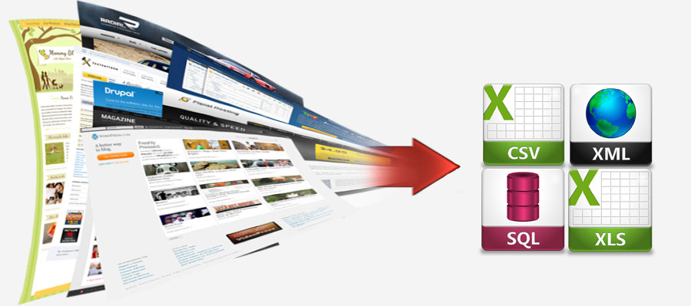
Scraping Obstacles
security - headers={'User-Agent': 'Mozilla/5.0'})
reorganising the database in the middle
secondary API for stock tickers
Preventing duplicates without natural primary key

Slide 6
Results

Slide 7

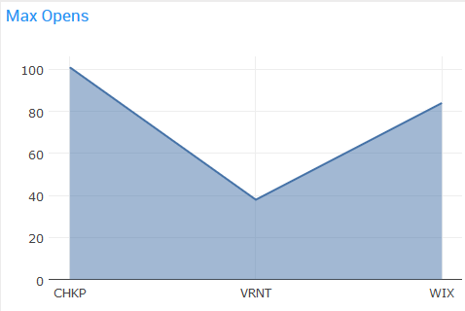
Primary Source
Enrichment
Almost 1,900 jobs scraped from over 2 months with metadata
128 jobs are at publicly traded companies
About two weeks of market data from Quandl

Slide 8
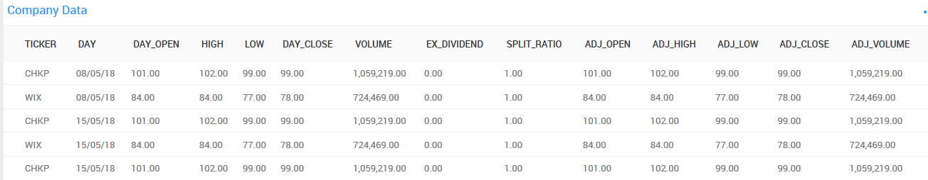
Quandl API
Yahoo API
Postel’s Law
Check Point, CheckPOint, check point inc -> CHKP (sometimes too good - manual check)
Quandl Python API
Returns Pandas Dataframe
10 columns of values
Designer
Company Name, Location
June 20XX - July 20XX

Slide 9
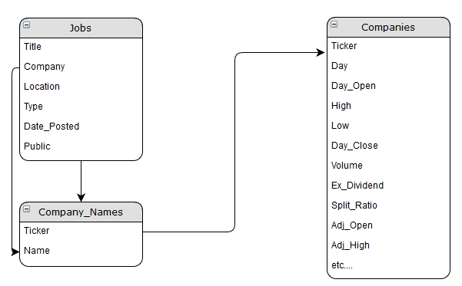
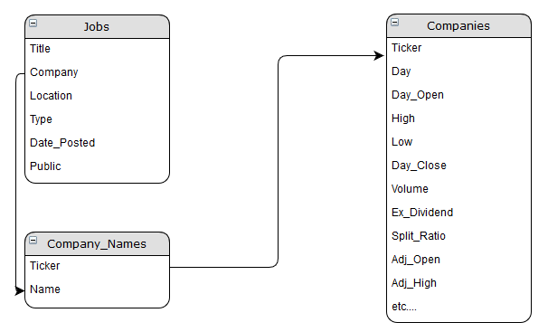
DB Structure
3 Tables

Slide 10
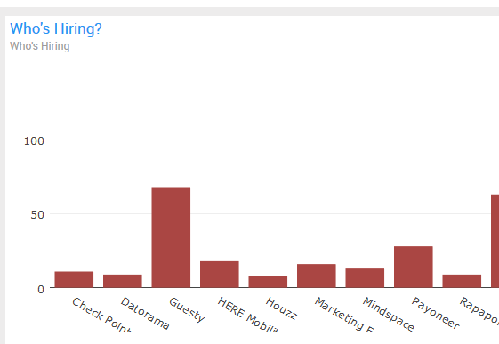
Conclusions
Lots of jobs…
Most companies on STA are startups / small tech companies
WIX the biggest employer
Few public companies, but easy to get their data
Less useful data on salaries/labour data than expected
(Glassdoor API is MIA)

